Slide 1
Design and Fabrication of Regenerative braking system
PRESENTED BY
Milan lamichhane 16n31a03g8
Surendra Yonjan 16n31a03h0
Navin Bhetal 16n31a03h4
UNDER THE GUIDANCE OF
MR.SUBBA REDDY
ASSISTANCE PROFESSOR

Slide 2
Introduction
A brake is a mechanical device that inhibits motion by absorbing energy from a moving system.
Regenerative braking system recovers the kinetic energy of the system.
In conventional braking system these kinetic energy were converted into heat energy to stop the vehicles.
Regenerative braking improves the efficiency by saving the energy.
It also improves the performance of vehicle by boosting the acceleration of vehicle.

Slide 3
Literature
S No. | Title | Author | Date of Publication | Problem | Solution
1. | Design & Fabrication of Regenerative braking system | Siddhartha K. Patil | May-October 2012 | Cannot recover all the energy. | Suggested for high torque generator.
2. | Design & Fabrication of Regenerative braking system | Anchal Kumar, Pulkit Gupta, Sandeepan Deva, Shay Pohjuy | May 2014 | Braking is not comfortable for some drivers. | Suggested for friction brake Drum.
3. | Design & Fabrication of Regenerative braking system | Yogesh Abhale , Prateek Nigam | July 2015 | The system requires a 20% empty starter battery for the system to work. | Using starter Battery and the Auxiliary system.
4. | Design & Fabrication of Regenerative braking system | Tribhuwan Singh, Shahzaj Ali | Feburary 2016 | This brake can stop the motor but cannot hold it stationery. | Suggested for cluch and flywheel for engaging and disengaging of parts.
5. | A Review Regenerative Braking Methodology in Electric Vehicle | Siddharth K Sheladia ,Karan K Patel ,Vraj D Savalia,Rutbik G Savalia | March 2018 | This could potentially cause skidding on the wheels with brakes. | Suggested for ABS (Anti lock Braking system )

Slide 4
objectives
To Improve Fuel economy of the hybrid vehicle.
To recover the energy loss during braking.
To improve the performance of the system.
To reduce the brake wear.

Slide 5
Methodology
Part Design (PTC Creo )
Analysis (Ansys)
Testing
Assembly
Selection of work
Procurement of Materials
Report Preperation
Literature
Fabrication

Slide 6
Work plan
S no. | Activities | Work plan in weeks
 |  | 0-1 | 1-2 | 2-3 | 3-5 | 6-13 | 13-14
1 | Selection of work
2 | Literature
3 | Methodology
4 | Design, Assembly & Analysis of components
5 | Fabrication and Testing
6 | Report preparation

Slide 7
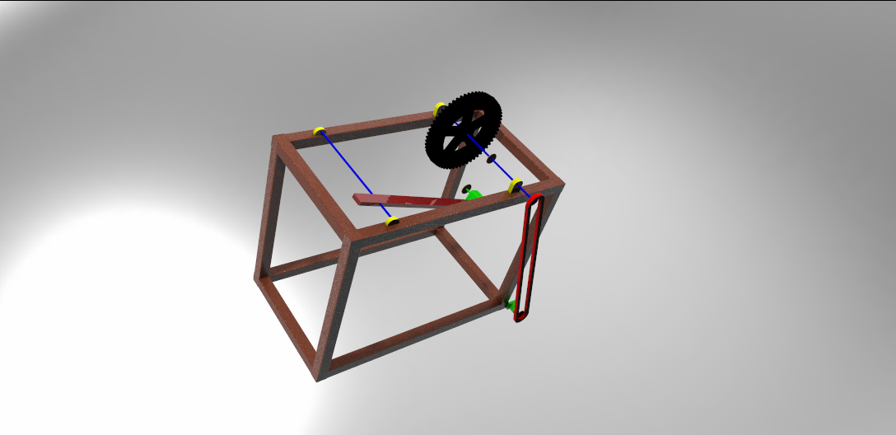
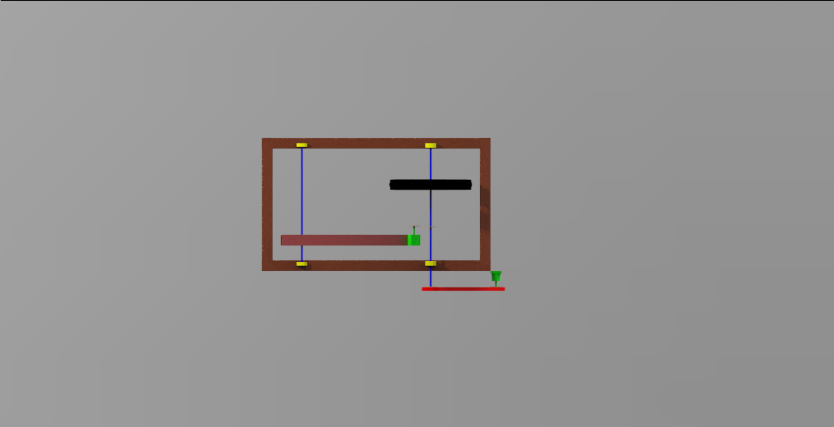
Design
Normal View
Front view

Slide 8
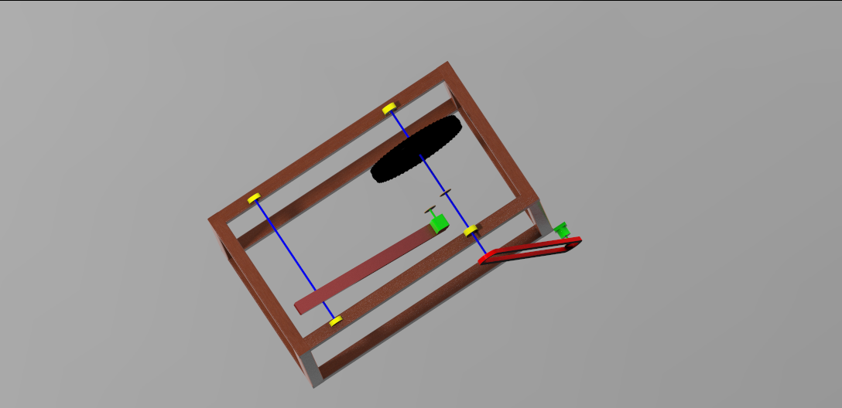
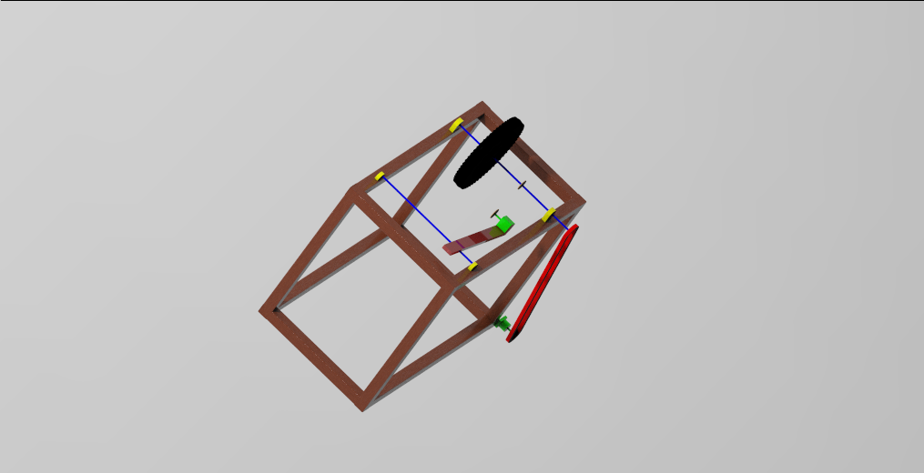
Design
top View
Normal view

Slide 9
List of materials
S.N | Name of Equipment | Description | Quantity | Price
1 | 40*40 square bar | Hollow Bar (M.S) | 9m
2 | Journal Bearing(with plumber block) | Internal Dia.12mm | 3 pcs
3 | Brake Wheel(Wheel Chair Front Wheel) | Outer Dia.10cm | 2 pcs
4 | Solid Shaft | Outer Dia.12mm | 1.5m
5 | Bicycle Wheel |  | 1 pcs
6 | 30*50 Brake Spindle | Hollow Bar (M.S) | 0.6m
7 | Sewing Machine Motor | 1440 rpm | 1pcs
8 | Pulley | Internal Dia.12mm | 2pcs
9 | Pulley Rope |  | 2m
10 | Bulbs | L.E.D | 10pcs
11 | Electric Wires |  | 6m
12 | Regenerative Motor | Stepper D.C 12v | 1pcs

Slide 10
Thank you

